Slide 1
Problem Solving with C Programming Language
Unit 5 Arrays in C Programming Language

Slide 2
One-Dimensional Arrays
An array is a data structure of C programming language that is used to specify an aggregation of homogenous data elements.
Syntax: type identifier[integer];
integer must be a positive integer number or an integer variable with positive value.
For example, the examination scores of a class of ten students is declared as:
An array can be declared with initial values.
Array score contains ten cells that each holds an integer element with the following initial values:
int score[10];
int score[10] = {78, 65, 90, 55, 82, 70, 49, 92, 82, 68};

Slide 3
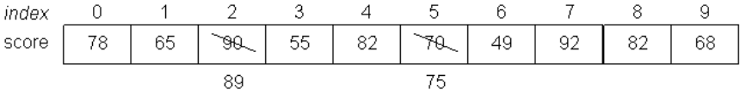
One-Dimensional Arrays (cont’d)
An array can also be partially initialized. For example, the following array declaration assigns initial values to score[0], score[1], score[2], score[3], score[4], score[5], and score[6]. Also, data elements score[7], score[8], and score[9] are set to zero's.
In C programming language, access of array elements are through the identifier of an array and an index.
For an array of n elements, the indices of its elements range from 0 to n-1. Therefore, array score has ten elements and the indices range from 0 to 9. The first element of array score is score[0], the second element score[1], etc.
An array element can be modified with an assignment statement:
With the above two assignments, array score is changed to:
int score[10] = {78, 65, 90, 55, 82, 70, 49};
score[2] = 89;
score[5] = 75;

Slide 4
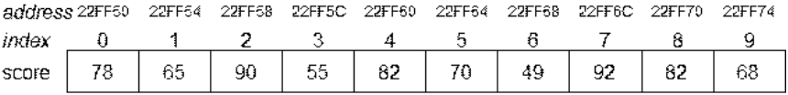
One-Dimensional Arrays (cont’d)
Array elements can be used in arithmetic expressions. The following statement assigns the average score to variable average:
Suppose the address register of a CPU is 32-bit long and the the size of an integer is four bytes.
If the starting address of score[0] is 0x22FF50, the array elements socre[1], score[2], ..., and score[9] are stored in the succeeding memory locations, i.e., the starting address of score[1] is 0x22FF54, the starting address of score[2] is 0x22FF58, ..., and the starting address of score[9] is 0x22FF74.
The addresses (in hexadecimal) of array elements score[i] are shown as the figure below:
average = (score[0]+score[1]+score[2]+score[3]+score[4]+score[5]+score[6]+score[7]+score[8]+score[9])/10;

Slide 5
One-Dimensional Arrays (cont’d)
In C programming language, the identifier of a one-dimensional array represents the address of the first array element. Example, program array_value_address_1D.c.
array_value_address_1D.c
Lines 6 and 7 output the content of array score and address of score[0], i.e., 0x22FF50.
Lines 9 and 10 prints the values of *score and score[0], where both values are 78. The notation *score is dereferencing of score once.
C programming language also allows arithmetic operation of address. In Line 12, score+2 is an arithmetic operation of address which means the address of score adds two times of the size of a given data type, that is 4 for the integer type. Hence, score+2 is equivalent to 0X22FF50+4*2 which is exactly the address of score[2], 0X22FF58, as the output of Line 13.
1
2
3
4
5
6
7
8
9
10
11
12
13
#include <stdio.h>
int main(void) {
int score[10] = {78, 65, 90, 55, 82, 70, 49, 92, 82, 68};
printf("Content of score: 0X%X \n", score);
printf("Address of score[0]: 0X%X\n\n", &score[0]);
printf("Value of *score: %d \n", *score);
printf("Value of score[0]: %d\n\n", score[0]);
printf("Content of score+2: 0X%X \n", score+2);
printf("Address of score[2]: 0X%X\n\n", &score[2]);

Slide 6
One-Dimensional Arrays (cont’d)
In C programming language, the identifier of a one-dimensional array represents the address of the first array element. Example, program array_value_address_1D.c.
array_value_address_1D.c
array_value_address_1D.exe
14
15
16
17
18
19
printf("Value of *(score+2): %d \n", *(score+2));
printf("Value of score[2]: %d\n", score[2]);
return 0;
}
Content of score: 0X22FF50
Address of score[0]: 0X22FF50
Value of *score: 78
Value of score[0]: 78
Content of score+2: 0X22FF58
Address of score[2]: 0X22FF58
Value of *(score+2): 90
Value of score[2]: 90
Lines 15 and 16 prints the values of *(score+2) and score[2], where both results are 90.

Slide 7
One-Dimensional Arrays (cont’d)
In general, let the starting address of array a[n] be loc and the type of the elements of a[n] be T.
We have the address of &a[0]==loc and the starting address of array element a[i] is given as, since there are i elements before a[i] and each element occupying sizeof(T) bytes:
a+i = &a[i] = loc + sizeof(T) * i.

Slide 8
Multi-Dimensional Arrays
Arrays in C programming language can be declared with multiple dimensions.
Syntax: type identifier[integer1][integer2];
integer1 and integer2 must be positive integer numbers or integer variables with positive values.
A two dimensional array is actually a one-dimensional array of integer1 elements such that each element is a one-dimensional arrays of size integer2 of the specified type type.
Consider the following two-dimensional array declaration:
Array data is a one-dimensional array of three elements data[0], data[1], and data[2] such that each element is a one-dimensional array of four elements.
int data[3][4];

Slide 9
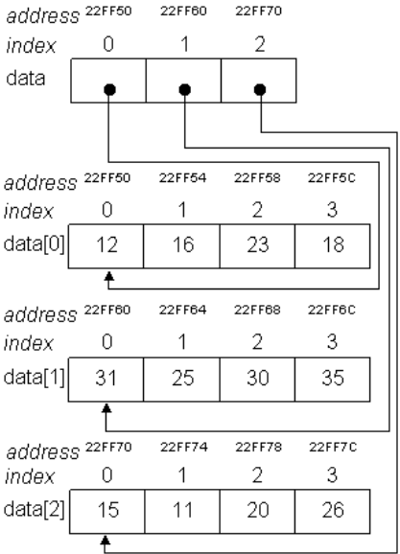
Multi-Dimensional Arrays
There are two ways to initialize a two-dimensional array in array declaration:
with a one-level list of numbers enclosed by curly brackets
with a two-level list enclosed by curly brackets such that the first
level elements are lists of numbers enclosed by curly brackets.
The diagram of array data[3][4] is depicted as:
int data[3][4] = {12, 16, 23, 18, 31, 25, 30, 35, 15, 11, 20, 26};
int data[3][4] = {{12, 16, 23, 18},
{31, 25, 30, 35},
{15, 11, 20, 26}};

Slide 10
Multi-Dimensional Arrays (cont’d)
Program array_value_address_2D.c shows the expressions of value and address of multi-dimensional array.
array_value_address_2D.c
array_value_address_2D.exe
1
2
3
4
5
6
7
8
9
10
11
12
13
14
#include <stdio.h>
int main(void) {
int data[3][4] = {{12, 16, 23, 18},
{31, 25, 30, 35},
{15, 11, 20, 26}};
printf("****** Case 1:\n");
printf("Address of data: 0X%X \n", &data);
printf("Content of data: 0X%X \n", data);
printf("Address of data[0]: 0X%X\n", &data[0]);
printf("Content of *data: 0X%X\n", *data);
printf("Content of data[0]: 0X%X\n", data[0]);
printf("Address of data[0][0]: 0X%X\n", &data[0][0]);
****** Case 1:
Address of data: 0X22FF50
Content of data: 0X22FF50
Address of data[0]: 0X22FF50
Content of *data: 0X22FF50
Content of data[0]: 0X22FF50
Address of data[0][0]: 0X22FF50

Slide 11
Multi-Dimensional Arrays (cont’d)
Lines 9 to 14 of Case 1 print the location of six expressions.
Expression &data (Line 9) is the address of array data.
Expression data (Line 10) is the contents of array variable data, which is a pointer to the address of one-dimensional array data[0].
This address is expressed as &data[0] (Line 11).
Expressions *data and data[0] (Lines 12 and 13) are the content of data[0], which is a pointer to the address of one-dimensional array data[0][0], i.e., &data[0][0] (Line 14).
In C programming language, these expressions point to the same location, e.g., 0X22FF50, the starting address of the array elements.

Slide 12
Multi-Dimensional Arrays (cont’d)
array_value_address_2D.c
array_value_address_2D.exe
15
16
17
18
1920
21
22
23
24
25
26
27
28
29
30
31
printf("\n****** Case 2:\n");
printf("Value of **data: %d\n", **data);
printf("Value of *data[0]: %d\n", *data[0]);
printf("Value of data[0][0]: %d\n", data[0][0]);
printf("\n****** Case 3:\n");
printf("Content of data+1: 0X%X \n", data+1);
printf("Address of data[1]: 0X%X\n", &data[1]);
printf("Content of *(data+1): 0X%X\n", *(data+1));
printf("Content of data[1]: 0X%X\n", data[1]);
printf("Address of data[1][0]: 0X%X\n", &data[1][0]);
printf("\n****** Case 4:\n");
printf("Value of **(data+1): %d\n", **(data+1));
printf("Value of *data[1]: %d\n", *data[1]);
printf("Value of data[1][0]: %d\n", data[1][0]);
****** Case 2:
Value of **data: 12
Value of *data[0]: 12
Value of data[0][0]: 12
****** Case 3:
Content of data+1: 0X22FF60
Address of data[1]: 0X22FF60
Content of *(data+1): 0X22FF60
Content of data[1]: 0X22FF60
Address of data[1][0]: 0X22FF60
****** Case 4:
Value of **(data+1): 31
Value of *data[1]: 31
Value of data[1][0]: 31

Slide 13
Multi-Dimensional Arrays (cont’d)
Lines 17 to 19 of Case 2 print values of three expressions, **data, *data[0], and data[0][0] all yield the value of array element data[0][0] which is 12.
Lines 22 to 26 of Case 3 print location of five expressions.
Expression data+1 (Line 22) is calculated using pointer arithmetic.
Expression data is a pointer to the address of one-dimensional array data[0]. Since an element of data[0] is a one-dimensional array of four elements, it is of size 16 bytes.
Therefore, data+1 the location of data[0] adding the size of its element, i.e., 0X22FF50+0X10=0X22FF60.
The location is exactly the address of expression &data[1] (Line 23).
Lines 24 and 25, *(data+1) and data[1] are the content of data[1] which is the address of array element data[1][0] (Line 26).
In Lines 29 to 31 of Case 4, the three expressions **(data+1), *data[1], and data[1][0] all refer to the value data[1][0] which is 31.

Slide 14
Multi-Dimensional Arrays (cont’d)
array_value_address_2D.c
array_value_address_2D.exe
32
33
34
35
36
37
38
39
40
41
42
43
44
printf("\n****** Case 5:\n");
printf("Content of *(data+1)+2: 0X%X \n", *(data+1)+2);
printf("Content of data[1]+2: 0X%X\n", data[1]+2);
printf("Address of data[1][2]: 0X%X\n", &data[1][2]);
printf("\n****** Case 6:\n");
printf("Value of *(*(data+1)+2): %d\n", *(*(data+1)+2));
printf("Value of *(data[1]+2): %d\n", *(data[1]+2));
printf("Value of data[1][2]: %d\n", data[1][2]);
return 0;
}
****** Case 5:
Content of *(data+1)+2: 0X22FF68
Content of data[1]+2: 0X22FF68
Address of data[1][2]: 0X22FF68
****** Case 6:
Value of *(*(data+1)+2): 30
Value of *(data[1]+2): 30
Value of data[1][2]: 30
Lines 34 to 36 of Case 5 all print the address of data[1][2]. Since expressions *(data+1) and data[1] are the address of data[1][0], expression *(data+1)+2 and data[1]+2 are the address of data[1][0] adding the size of two integer elements, i.e., data[1][0]+4*2=0X22FF68, that is the address of data[1][2].
Lines 40 to 42 of Case 6 print the value of data[1][2] which is 30.

Slide 15
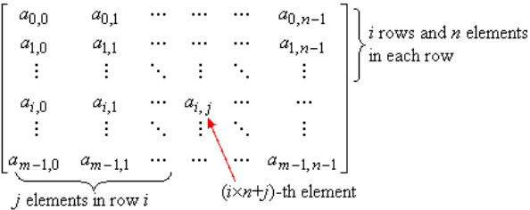
Multi-Dimensional Arrays (cont’d)
In general, let the starting address of two-dimensional array a[m][n] be loc and the type of the elements of a[m][n] be T. Let us view array a[m][n] as the following m×n matrix:
Suppose the matrix elements are stored in memory in the row-major order. Recall that the matrix indices starts from (0,0), There are i rows before element a_{i,j} such that each row has n elements, and there are j elements in row i before element a_{i,j}. Totally, there are i×n+j elements, that each element is of sizeof(T) bytes, in front of a_{i,j}. We have the address of &a[0][0]=loc and the starting address of array element a[i][j] is given as:
*(a+i)+j = a[i]+j = &a[i][j] = loc + sizeof(T) × (i × n + j).

Slide 16
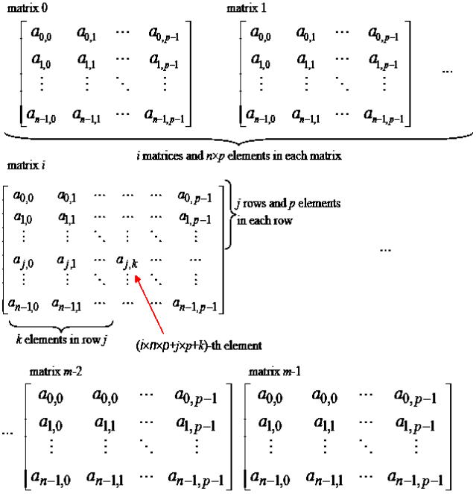
Multi-Dimensional Arrays (cont’d)
Let the starting address of three-dimensional array a[m][n][p] be loc and the type of the elements of a[m][n][p] be T. Let us view array a[m][n][p] as the following m matrices of size n×p:

Slide 17
Multi-Dimensional Arrays (cont’d)
Suppose the matrix elements are stored in memory in the row-major order.
Recall that the matrix indices starts from (0,0,0).
There are i matrices, of size n×p, before the one containing matrix i.
In matrix i, there are j rows before element a_{j,k} such that each row has p elements, and there are k elements in row j before element a_{i,j}.
Totally, there are i×n×p+j×p+k elements, that each element is of sizeof(T) bytes, in front of a_{j,k} of matrix i.
We have the address of array a is &a[0][0][0]=loc and the starting address of array element a[i][j][k] is given as:
&a[i][j][k] = loc + sizeof(T) × (i × n × p + j × p + k).

Slide 18
Sequential Search
Suppose a sequence of data are stored in a one-dimensional array, say, a[n]. The search problem is to find whether a specific data value, say, key, is an element of the data sequence and to determine which element is the specific data value if it exists.
Let us assumed the sequence is stored in the arbitrary order.
When we solve a problem, it is important to figure out a way, or called a procedure, that will achieve the goal of the problem effectively.
For example, an easy way to carry out the search is to pick up a data element in a[i], where 0≤i<n, randomly and check if a[i] is of value key.
Repeat this process until an element with value key is found or all the elements are checked.

Slide 19
Sequential Search (cont’d)
Since we are going to solve a problem with a computer, it is also important that the solution must be a stepwise procedure that can be understood or be performed on a computer.
A stepwise procedure that can be performed on a computer is called an algorithm.
For example, the above searching procedure needs to be refined further to become a searching algorithm:
How to pick up an element a[i] randomly, and
How to make sure all elements have been checked, if key is not an element of a[n].
To refine the procedure, we can do the following steps:
Use a random number generator, which is supported by most programming language such as C, to decide which element to check.
Mark the elements that have been checked. This can be done by using another array, say, checked[n], to store the marker.

Slide 20
Sequential Search (cont’d)
However, the computation of random number generation is costly and the use of an additional array also consumes memory space.
We may modify the procedure in a much easier way: check the elements starting from a[0], then a[1], a[2], and so on, until key is found or a[n] is reached.
The modified steps can be written as the following pseudo code:
Input: an array a[n] and a value key.
Output: if key is an element of a[n], find that element; otherwise, report not found.
Set i to 0, and set found to false.
If a[i]==key, then a[i] is the searched element and set found to true; otherwise set i to i+1.
If found is true or i==n, then the search is done; otherwise go to step 2.

Slide 21
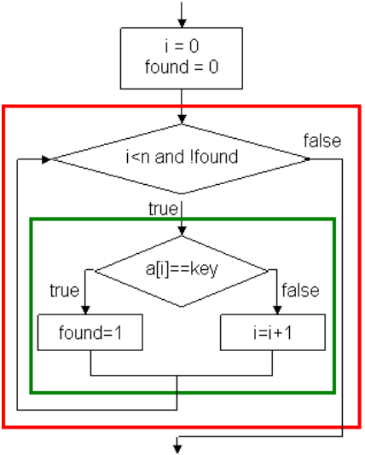
Sequential Search (cont’d)
This search algorithm is known as sequential search algorithm.
We draw the flowchart of sequential search algorithm as the following:
At the end of this flowchart, if found==1 then the search succeeds and a[i] is element being found; otherwise, the search fails.

Slide 22
sequential_search.c
sequential_search.exe
1
2
3
4
5
6
7
8
9
10
11
12
13
14
15
16
17
18
19
20
21
22
#include <stdio.h>
int main(void) {
int i, found, key;
int a[8] = {3, 8, 7, 2, 5, 4, 9, 2};
printf("Enter a searched key: ");
scanf("%d", &key);
i = 0;
found = 0;
while (i<8 && !found) {
if (a[i]==key) found = 1;
else i++;
}
if (found) printf("Search succeeds. a[%d]=%d.\n", i, a[i]);
else printf("Search fails. %d does not exist in the sequence.\n", key);
return 0;
}
Enter a searched key: 7
Search succeeds. a[2]=7.
Enter a searched key: 6
Search fails. 6 does not exist in the sequence.

Slide 23
Sequential Search (cont’d)
Observing that if the value of a[0] equals to key, only one iteration of the while-loop is executed; if all values from a[0] to a[n-2] do not equal to key, either a[n-1] equals to key or the search fails and n iterations of the while-loop are executed.
In average, n/2 iterations are executed and we say the time complexity of the sequential search algorithm is n/2.
Program sequential_search_short_circuit.c is an alternative way to implement the sequential search algorithm.
In the while-loop (Line 12), the loop terminates when i≥8, search fails, or, a[i]==key, search succeeds.
In the case of search failing, i is set to 8 and the second part of the loop condition will access a[8], which causes an error of segmentation fault, also known as array out of range.
However, C programming language evaluates this condition using a technique called short-circuit evaluation to avoid the error.

Slide 24
sequential_search_short_circuit.c
1
2
3
4
5
6
7
8
9
10
11
12
13
14
15
16
17
18
#include <stdio.h>
int main(void) {
int i, key;
int a[8] = {3, 8, 7, 2, 5, 4, 9, 2};
printf("Enter a searched key: ");
scanf("%d", &key);
i = 0;
while (i<8 && a[i]!=key) i++;
if (i<8) printf("Search succeeds. a[%d]=%d.\n", i, a[i]);
else printf("Search fails. %d does not exist in the sequence.\n", key);
return 0;
}
Short-circuit evaluation is a technique that will return the result of an expression as soon as the result of the expression is determined by partial evaluation. For example, evaluation of condition p∧q will return false if p is evaluated to false and expression q is ignored; evaluation of condition p∨q will return true if p is evaluated to true and expression q is ignored. Hence, when i is 8, condition i<8 && a[i]!=key returns false without evaluating the second expression a[i]!=key.

Slide 25
Bubble Sort
Suppose a sequence of n elements are stored in a one-dimensional array, a[n]. The sorting problem is to rearrange the elements of a[n] so they are in ascending or descending order.
A simple sorting algorithm is the bubble sort. The bubble sort algorithm has two nested loops.
The outer loop deals partial sequences of a[n]. It starts from the entire sequence and, in each of the following iterations, the last element of the sequence is removed.
The inner loop scans all elements of a given sub-sequence and selects the element with the maximum value.
After the inner loop is completed, the selected element is swapped with the last element. Hence, at the end of the outer loop, the maximum value of the sequence is "bubbled" up to the right-most position of that sequence.
Variable max is used to record the current maximum value and inx to record the selected element.

Slide 26
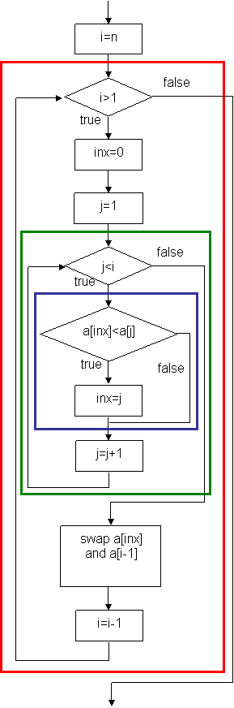
Bubble Sort (cont’d)
Pseudo code:
Input: an array a[n].
Output: elements of a[n] in ascending order.
1. Set i to be the length of the entire sequence.
2. While i>1 do
2.1. inx = 0;
2.2. j = 1;
2.3. While j<i do
2.3.1. If a[inx]<a[j] then inx=j;
2.3.2. j = j + 1;
2.4. swap a[inx] and a[i-1];
2.5. i = i - 1;

Slide 27
bubble_sort.c
bubble_sort.c
1
2
3
4
5
6
7
8
9
10
11
12
13
14
15
16
17
18
19
#include <stdio.h>
int main( ) {
int data[10] = {5, 12, 6, 8, 3, 10, 4, 5, 7, 9};
int i, j, inx, max;
printf("The initial sequence:");
for (i=0; i<10; i++) printf("%3d", data[i]);
printf("\n");
for (i=10; i>1; i--) {
inx = 0;
for (j=1; j<i; j++)
if (data[inx]<data[j]) inx = j;
max = data[inx];
data[inx] = data[i-1];
data[i-1] = max;
}
20
21
22
23
24
25
printf("The sorted sequence:");
for (i=0; i<10; i++) printf("%3d", data[i]);
printf("\n");
return 0;
}
bubble_sort.exe
The initial sequence: 5 12 6 8 3 10 4 5 7 9
The sorted sequence: 3 4 5 5 6 7 8 9 10 12
The comparison operation of Line 14 is evaluated (n-1)+(n-2)+...+1=n(n-1)/2 times.
That is, the complexity of the bubble sort algorithm is n(n-1)/2.

Slide 28
Binary Search
The complexity of the sequential search algorithm is n/2.
However, in many computer applications data are stored in sorted order. Searching in a sorted sequence can be accomplished in a much more efficient way using the binary search algorithm.
The binary search algorithm tests the element in the middle.
If it is the searched key, search is done successfully.
If it is not the searched key and the middle element is greater than the searched key, then the left half of the sequence is searched;
if the middle element is less than the searched key, the right half element of the sequence is searched.
Each time an element is tested with unmatched result, half of the sequence is trimmed. Hence, it takes only log₂n comparisons to search a sequence of n elements.

Slide 29
Binary Search(cont’d)
Pseudo code:
Input: a sorted array a[n] and a value key.
Output: if key is an element of a[n], find that element; otherwise, report not found.
1. Set low to 0, set high to n-1, and set found to false.
2. If the key is not found and low≤high then,
2.1. Set mid to low + (high - low) / 2.
2.2. If a[mid]==key, then a[mid] is the searched element, set found to true;
2.3. otherwise, if a[mid]>key,
2.3.1. then set high to mid-1;
2.3.2. otherwise, set low to mid+1.
2.4. Go to Step 2.
Try to draw the flow chart of the binary search algorithm.

Slide 30
binary_search.c
binary_search.exe
1
2
3
4
5
6
7
8
9
10
11
12
13
14
15
16
17
18
19
20
21
#include <stdio.h>
int main( ) {
int data[10] = {3, 4, 5, 5, 6, 7, 8, 9, 10, 12};
int low = 0, high = 9, mid, found = 0, key;
printf("Enter a searched key: ");
scanf("%d", &key);
while (!found && low<=high) {
mid = low + (high - low) / 2;
if (data[mid]==key) found = 1;
else if (data[mid]>key) high = mid -1;
else low = mid + 1;
}
if (found) printf("Search succeeds. data[%d]=%d.\n", mid, data[mid]);
else printf("Search fails. %d does not exist in the sequence.\n", key);
return 0;
}
Enter a searched key: 7
Search succeeds. data[5]=7
Enter a searched key: 11
Search fails. 11 does not exist in the sequence.

